Slide 1


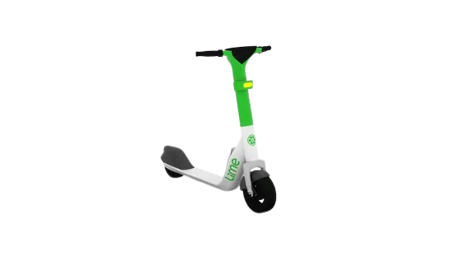
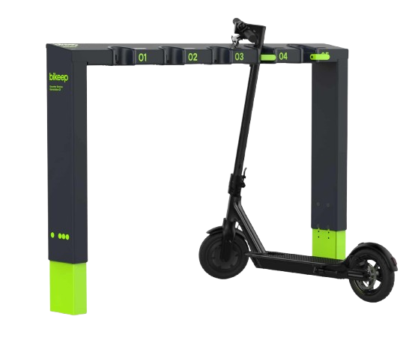
Management of Shared Mobility
Master's in Artificial Intelligence (M.IA)
Modelling and Simulation (M.IA029)
Problem Formalization | Methods & Tools
Group IA1_20
Eduardo Passos
Guilherme Silva
Valentina Cadime

Slide 2



Problem Addressed
Project focus: daily management of shared electric scooter fleets (Topic 7)
Motivation: shared electrical mobility is becoming common in cities. Management is important.
Aim: minimize operating costs while maximizing service, in quantity and quality
Shared scooters/bikes suffer from spatial and temporal imbalance
Demand varies by time of day, location, weather and events
Stations may become empty or saturated, reducing availability
Vehicles have battery constraints and charging delays
Operators must balance service quality vs operational cost
clear
cloudy
rain
storm

Slide 3

Project Objectives
Build a realistic simulation of an urban micromobility system
Model demand, travel, battery, charging and relocation
Incorporate stochastic exogenous factors (weather, events)
Evaluate baseline, heuristic, and reinforcement policies learning under multiple scenarios
Analyze trade-offs between availability, queues and cost

Slide 4
Methodology
Space Definition:
10 well-spaced station locations from Porto’s bike network (using OpenStreetMap API)
Pairwise distances and travel times computed using shortest bike paths
Defined station parameters: capacity, demand, energy consumption
Modelling:
Discrete-time simulation: 5-min ticks (steps)
Configuration and State
Agent-Environment interface: RL-style API
reset(), step()
observations
actions (act ∈ ℝ⁴)
Scenarios and Events:
Weather: Discrete-time Markov chain
Demand Peaks: Morning and evening rush hour
Events: Random temporary boosts in demand (concerts, sports games, etc.)

Slide 5
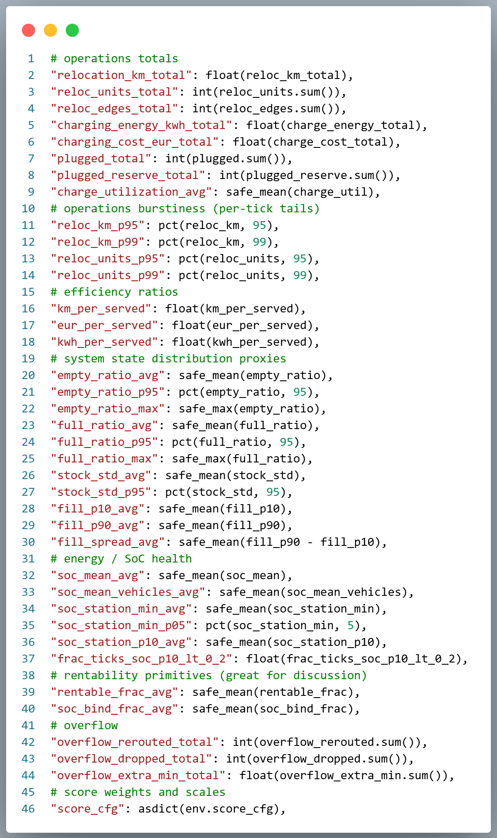
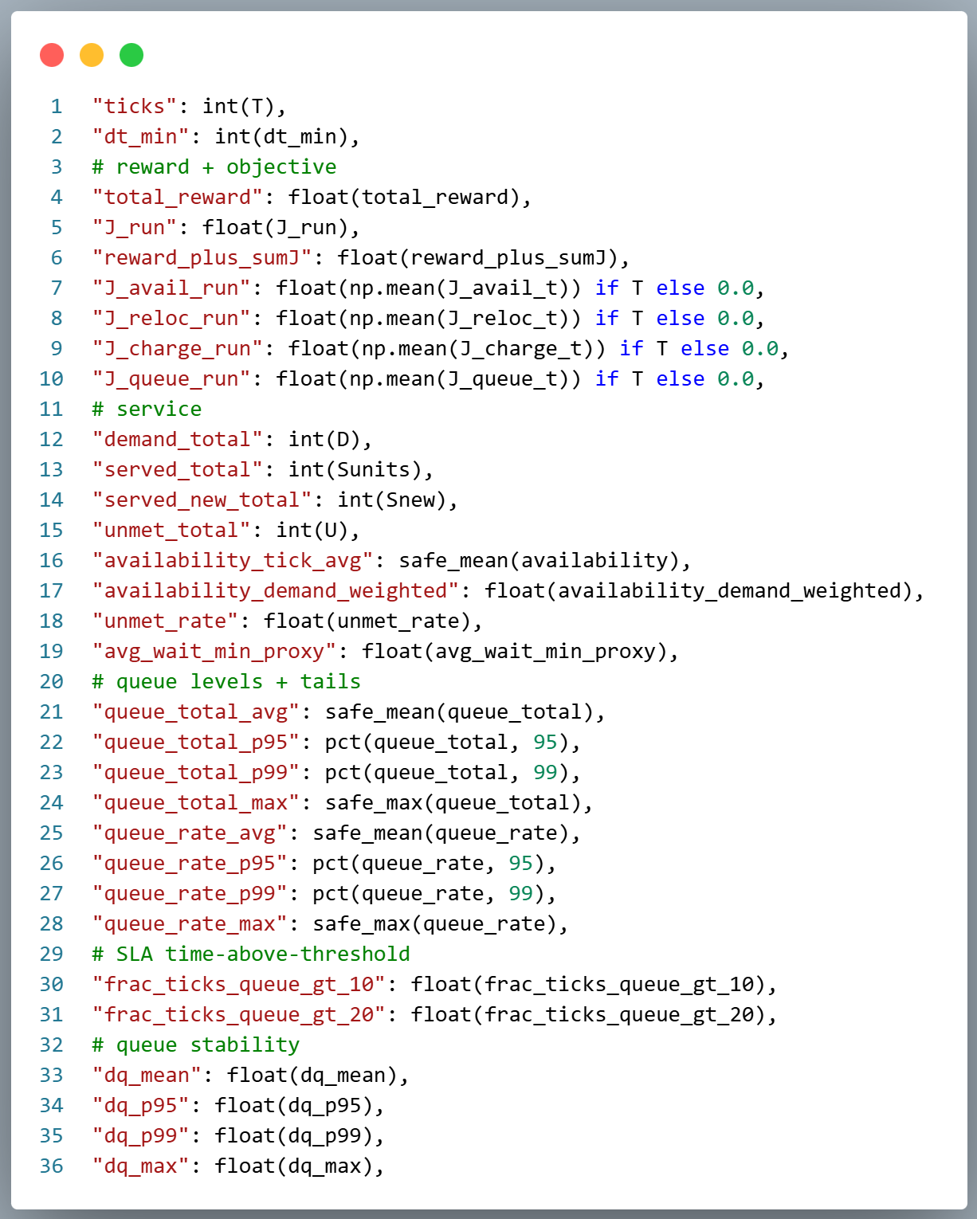
Methodology
Planners: Stored in a registry for easy swapping
Relocation
Greedy: From overfilled stations to near-empty ones
Budgeted: Greedy but with a maximum limit per tick
Charging
Greedy: Prioritize charging at low-battery stations
Slack: Charge at stations with low expected demand
Extra: No-op planner for comparison
Metrics and KPIs:

Slide 6

Simulation Demonstration

Slide 7
Experimental Work: Algorithms
Heuristic Agent: Manually crafted rules
Throttles actions based on previous performance (reloc. and charging EWMA)
Adapts to time-of-day, waiting queues, station occupation
Episodic Multi-Armed Bandit: UCB1
Search of different combinations (arms) of relocation and charging budgets
One combination per simulation episode
After many episodes, the arm with the best average reward is learnt (for that specific constant action)
Contextual Bandit: LinUCB
Re-selects budget combinations every “block” (e.g. hour), instead of every episode
Uses the state of the system and a linear model that predicts the expected reward to pick an arm
Soft-Actor Critic (SAC): RL
Learns a policy (Deep Neural Network) that maps continuous observations to actions
Finds highest cumulative reward
Improves modelling of uncertainty in demand (events, weather) through entropy maximization

Slide 8
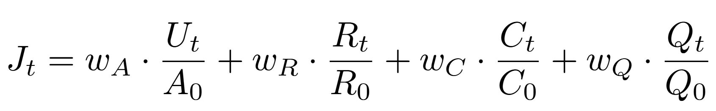
Experimental Work - Setup
Calibration procedure:
Each raw signal has different units and scales
A calibration script was used to
Run reference policies under nominal conditions
Estimate typical magnitudes of each signal
Set normalization constants so that all terms contribute comparably
Weight design rationale
wA = 5
wQ = 4
wR = 1
wC = 1
Chosen KPIs:
Availability: measures service quality
Queue Size: captures user waiting and congestion
Relocation Distance: reflects operational effort
Charging cost: accounts for energy expenditure
Normalized per-tick objective:

Slide 9
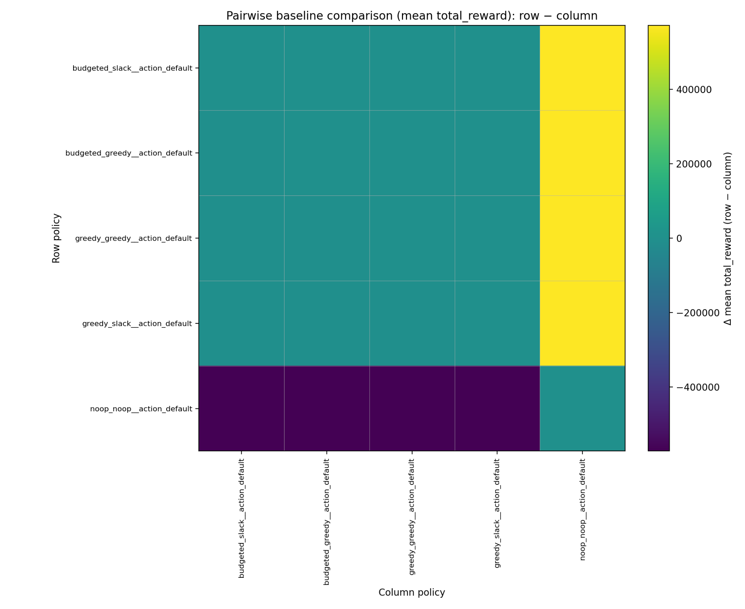
Baselines
Baseline set: no-op, greedy, budgeted, slack
Evaluation: same seeds, same action
Metric: mean total reward (pairwise)
Observation: all active baselines ≫ no-op
Observation: Greedy, budgeted, and slack are near-equivalent in reward

Slide 10
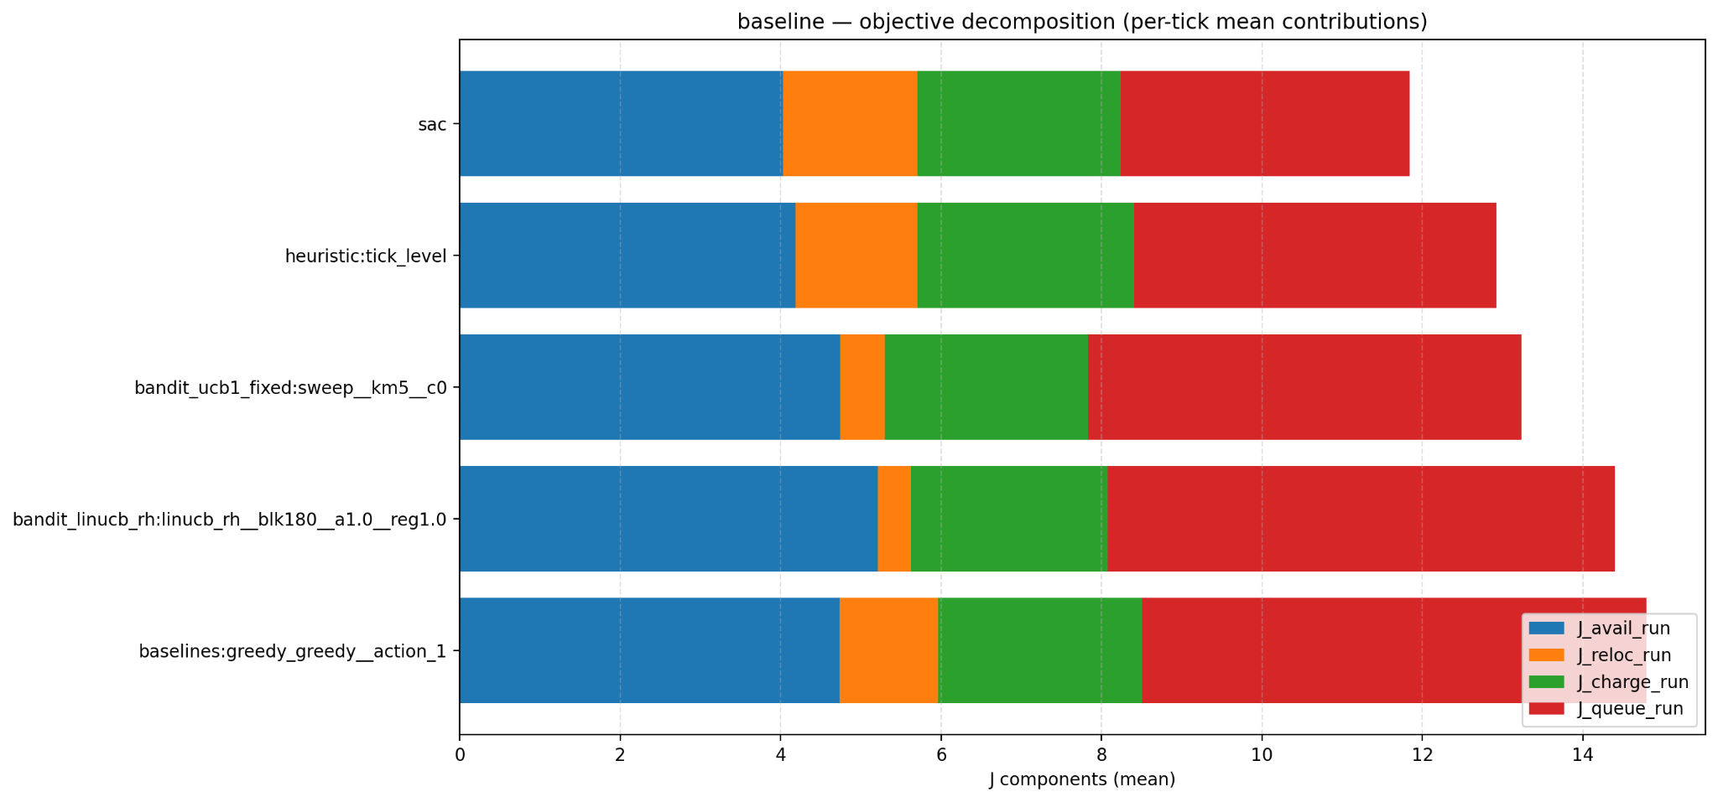
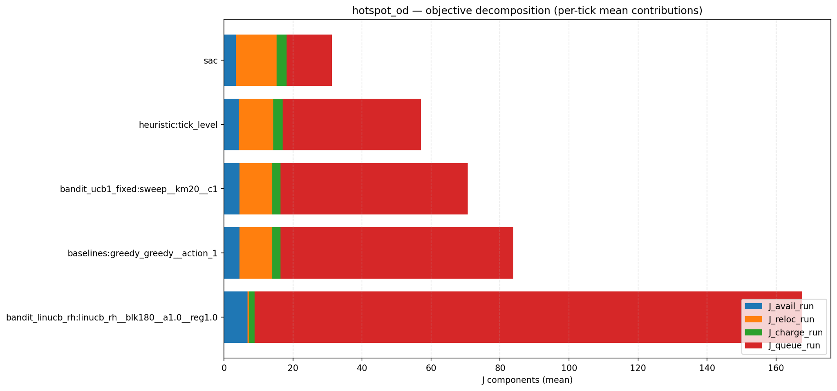
Analysis of Results

Slide 11
Critical Analysis and Directions for Future Work
Critical Analysis
Performance differences are dominated by queue dynamics, not operational costs
Queue penalties dominate J_run in all scenarios
Heuristics fail under demand heterogeneity
Bandits reduce cost but sacrifice service quality
Future Work
Queue-aware learning objectives
Multi-timescale decision making:
Fast loop for queue mitigation
Slow loop for fleet balancing
Different frequencies so that agents can react to sudden spikes in demand, while not affecting the management in the long run (can be affected by noisy rewards from per tick action).
Evaluate agents under different maps:
Maps with location nodes farther away from each other
Maps with more points overall

Slide 12
Thank you!
Any questions?

Slide 13
Backup slides

Slide 14
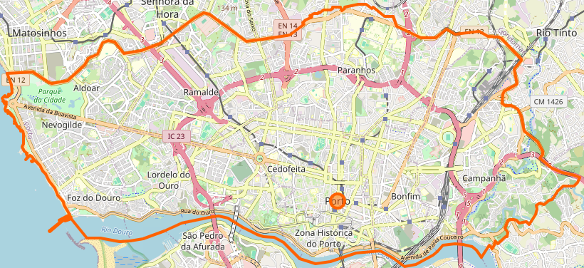
Physical Space Generation

Slide 15
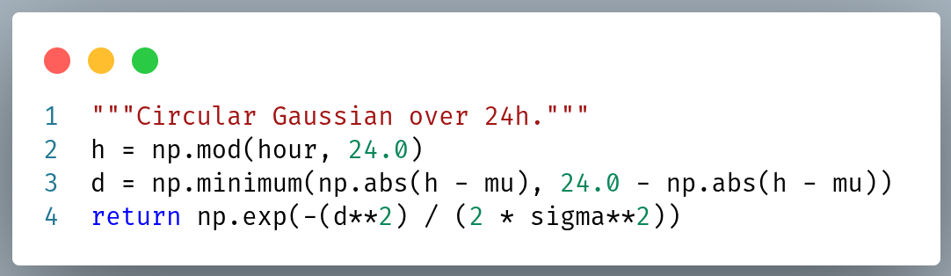
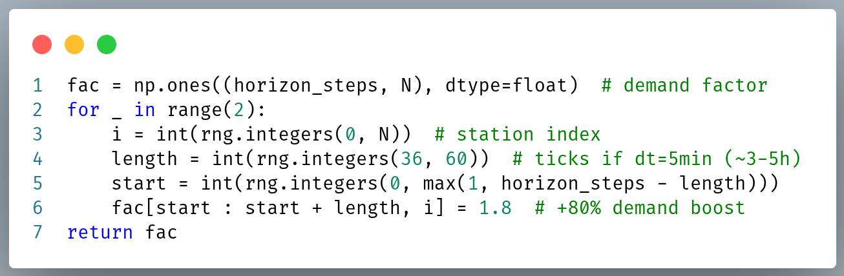
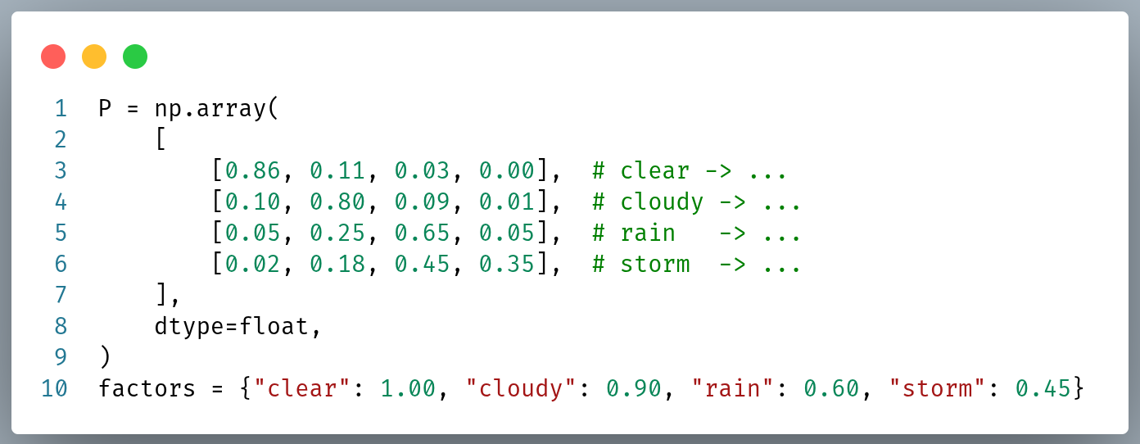
Modelling: Demand

Slide 16
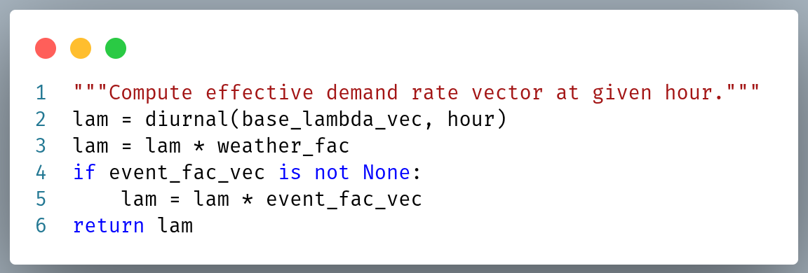
Modelling: Full Demand

Slide 17
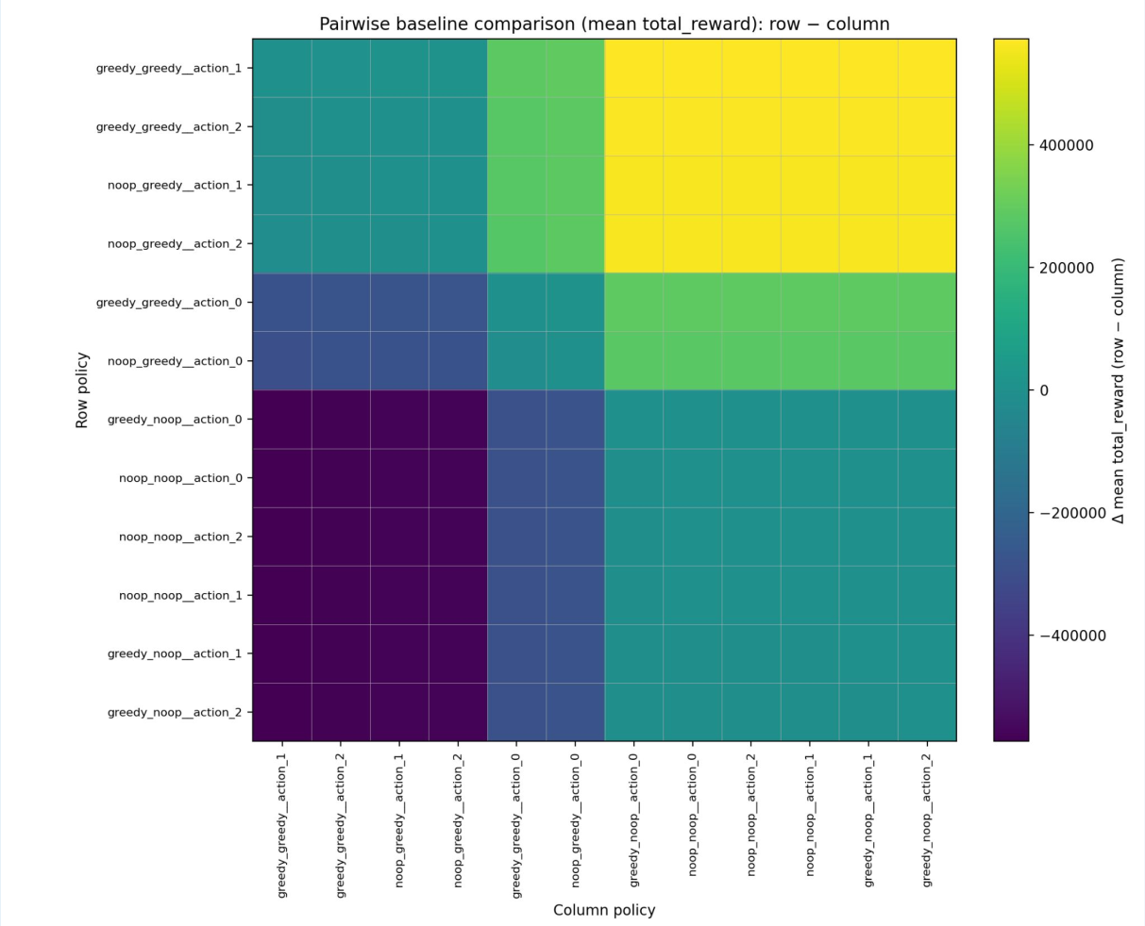
Planner Algorithms Comparison

Slide 18
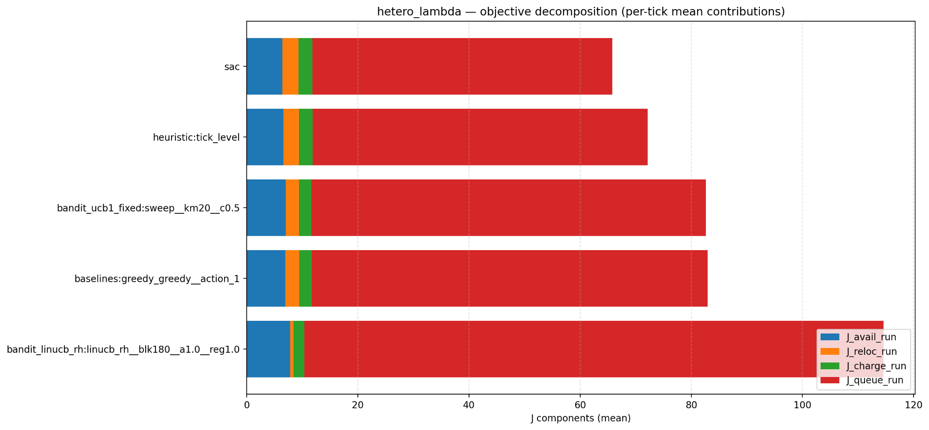
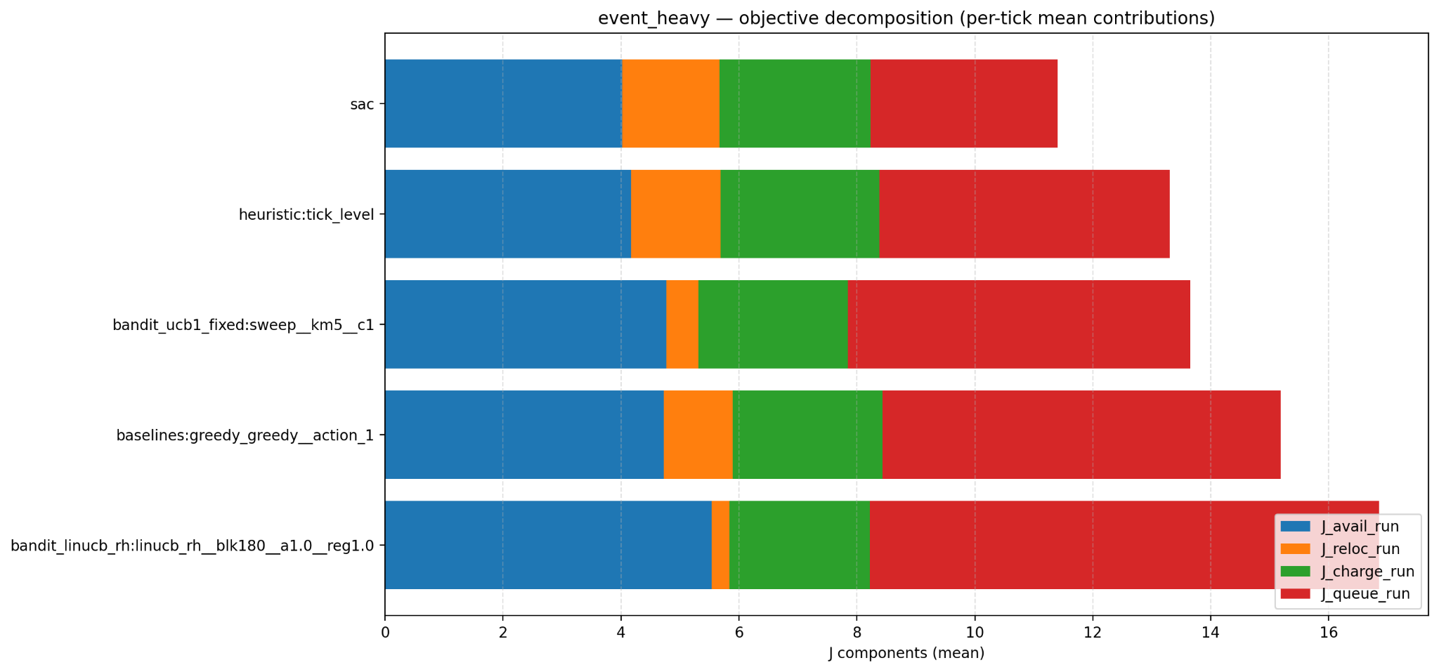
More Scenarios

